Slide 1
Trading strategies
Group 9 Final Project Presentation
Zhengxuan Yan, Qinyan Wu, Jialin Xuan
12.14.2021

Slide 2
Project overview
P A R T 0 1

Slide 3
Project introduction
P A R T 0 1
In this project, we built four trading strategies in stock market by using four machine learning techniques.
In back test framework, we used historical data of a certain stock to test the performance and compare it with a Naïve Strategy for reference.
Logistic regression, SVM, Gradient boosting and Random forest were applied to build strategies.
Three evaluation indicators were used to test the performance of our strategy. (Return: PnL, Risk: Sharp ratio and Feasibility: Decay)

Slide 4
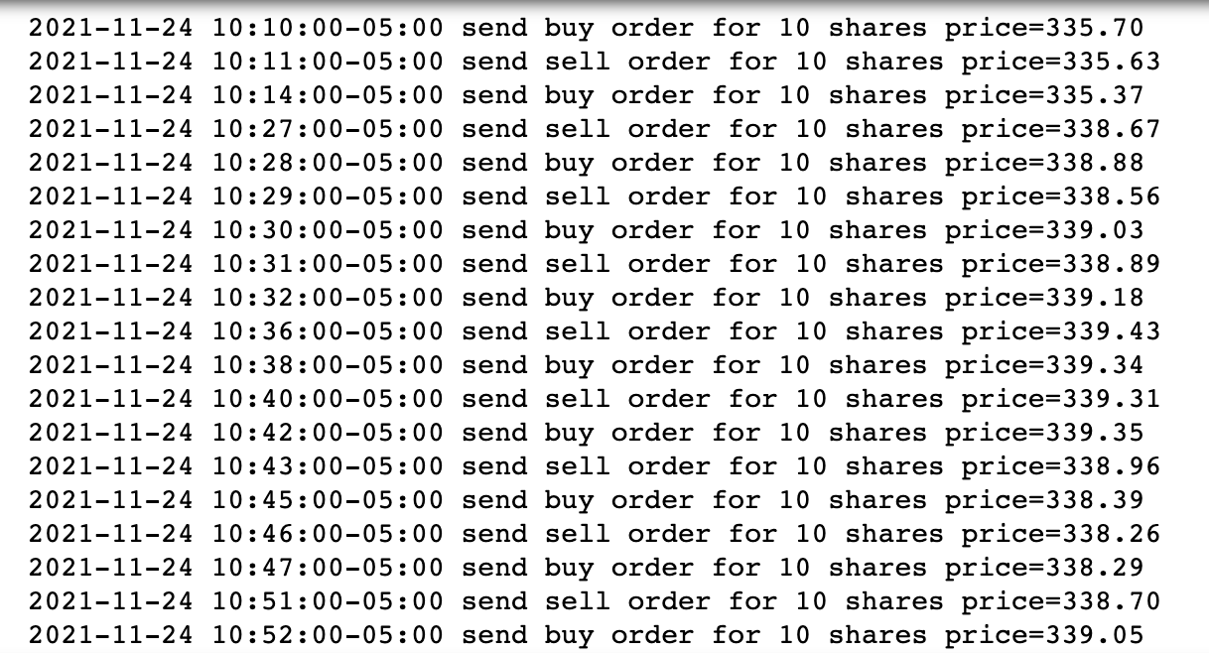
Project Goal
P A R T 0 1
The goal of this final project is to build four trading strategies to determine the signal aka. when to sell, buy or hold a certain amount of stocks, in this case each order is 10 shares, then to choose the best strategy by using evaluation indicators.
Part of the strategy output:

Slide 5
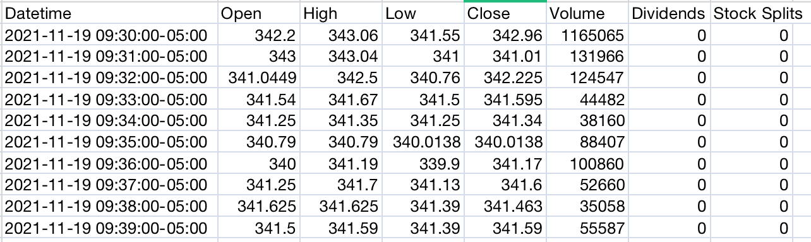
Data
P A R T 0 1
Data was imported from Yahoo Finance through yfinance package.
Seven-day minute high frequency market data of Facebook stock (2021-11-19 to 2021-11-30) was used throughout strategies.
Using high frequency data because it is less influenced by macroeconomic or exogenous events compared with the decadal daily frequency data. Since factors aka. parameters we chose in ML algorithms were all based on price and volume data which ignored exogenous affects, it was more suitable.
Due to the restriction of Yahoo Finance, we could only download the 7 days in row high frequency data, which might be insufficient for effective model training and back testing, but it could be refined in the future.

Slide 6
P A R T 0 1
Design of Parameters and Labels
Label (1, 0 dummy variable)
Binary variable 0 or 1 which can be used for classification:
1 If given current price is higher than the previous price (last minute), else 0
Paramaters / factors (12 parameters were used)
Selection of parameters was inspired by World Quant 101’s price volume factor mining method. All the parameters we chose included the change of price, volume, swing themselves and also the relation between the price and volume. Which can to some extent explain the change of the stock price.

Slide 7
Cont’d
P A R T 0 1
Close: (minute price), Volume: (minute volume)
Open – Close: cover the final change of price in each time interval
High – Low: cover the swing of price within the time interval
Deviation of price and volume: = -1 * corr(price(last 10 days), volume(last 10 days)), which covers the correlation between the price and volume within the time interval
Price Gap: = open_price(today) / close_price(last day), cover the gap between current open price and previous close price
Abnormal volume: = -1 volume(today) / mean(volume (last 10 days)), cover abnormal volume change within previous 10 days which can lead to the abnormal price changes and returns
Volume Swing Deviation: = -1 * corr(high(last 10 days) / low(last 10 days), volume(last 10 days)), cover the correlation between the volume and the swing
Volume Reverse: = min(-volume, 10), cover the reverse and the trend variation of volume
Price Reverse: = ts_corr(-high, log(close), 5), cover reverse and the trend variation of price

Slide 8
P A R T 0 1
Naive Strategy for Reference
We use the naïve strategy that start with buying, then a buy or sell operation is carried out every five minutes, which means that a round of buying and selling is carried out every ten minutes.
The naive strategy is designed for reference, to test the effectiveness of machine learning strategies.

Slide 9
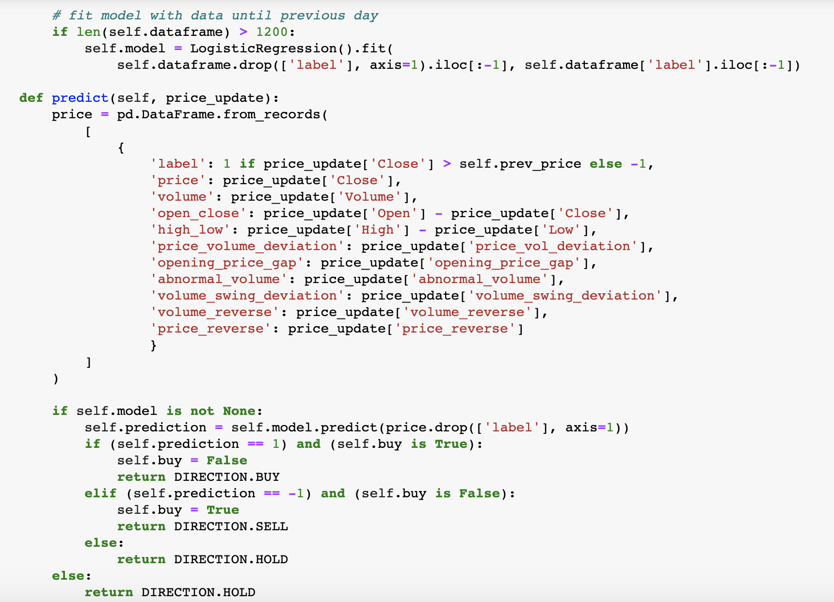
P A R T 0 1
Logistic Regression
Fit the model with inputs:
'price': ['Close’]
'volume’
'open_close’
‘high_low’,
'price_volume_deviation’
'opening_price_gap’
'abnormal_volume’
'volume_swing_deviation’
'volume_reverse’,
'price_reverse’.

Slide 10

P A R T 0 1
Support Vector Machine
Again, we fit the model with the same factors as before.
Parameters used:
‘Sigmoid’ kernel is chosen because it is more efficient when dealing with non-linear separable dataset, and less likely to overfit the model.

Slide 11
P A R T 0 1
Gradient Boosting
Gradient boosting: Gradient boosting uses gradient (direction of quickest improvement) for finding a solution. At each step the new learner tries to improve bad solutions of predecessors, without making good previous solutions.
Again, we fit the model with the the same factors as before.
Parameters used:
number of estimators = 100
Learning rate=1.0，to make the model more stable to predict.
Max depth=1, to control the overfitting.

Slide 12
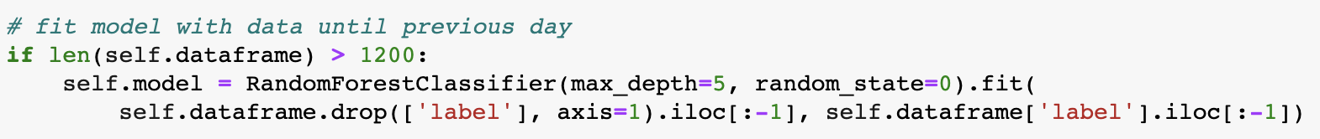
P A R T 0 1
Random Forest
Again, we fit the model with the same factors as before.
Parameters used:
Maximum depth is set to 5 to avoid overfitting and too complex model.

Slide 13
P A R T 0 1
Trading patterns
We follow the transaction rules of first making a purchase and then placing a sell order, subsequently maintaining a single buy and sell transaction, where the single transaction is for 10 shares.
Three evaluation indicators were used to test the performance of our strategy
Return: PnL, which equals to the stock position plus cash and minus the initial asset.
Risk: Sharp ratio, which follows the equation that is(asset return-risk free rate)/ standard deviation of the asset excess return.
Feasibility: Decay, which is calculated by the profit and loss after 5 minutes of a trade.
Evaluation system

Slide 14
Model Analysis
P A R T 0 2

Slide 15
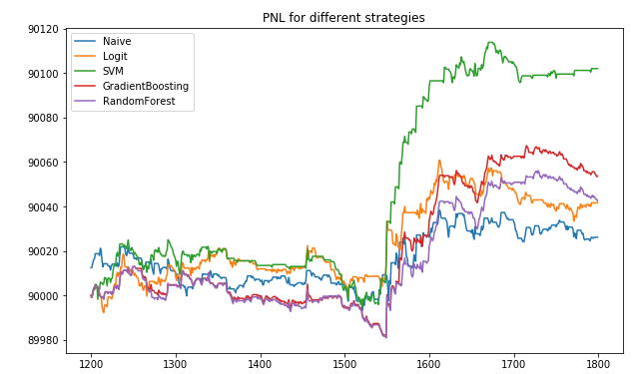
Profitability--PNL
P A R T 0 2
Through backtesting on the historical data, we can see from the graph that SVM gives the best PNL (90101.98$) and Naive Strategy gives the lowest PNL.
All the machine learning based strategies achieved better PNL than the Naive Strategy, indicating that they are more able to seize opportunities to make profits.

Slide 16
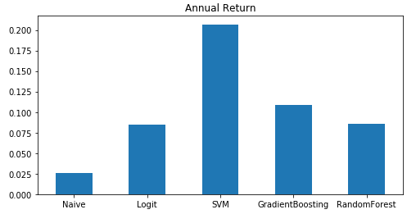
Profitability--Annual Return
P A R T 0 2
Due to lack of minute-level data, the change of PNL is relatively small, while the annual return can show the profitability of the strategies more clearly.
We can see from the graph that the strategy based on SVM has the highest annual return, which is 20.68% and the Naive Strategy has the lowest annual return, shich is 2.61%, which further prove what we have concluded earlier.

Slide 17
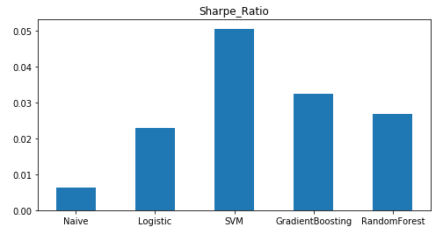
Risk--Sharpe Ratio
P A R T 0 2
Sharpe Ratio is the average return earned in excess of the risk-free rate per unit of volatility.
The Sharpe Ratio of all machine learning based strategies are higher than that of the naive strategy.
Among the five strategies, the SVM model has the highest Sharpe Ratio while the Naive Strategy has the lowest Sharpe Ratio. This result further indicates that the SVM performs much better in this case.

Slide 18
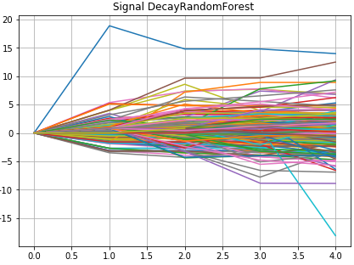
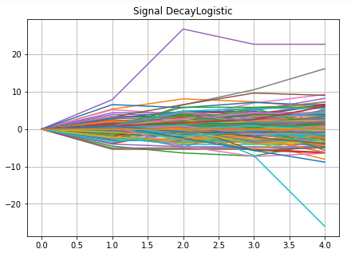
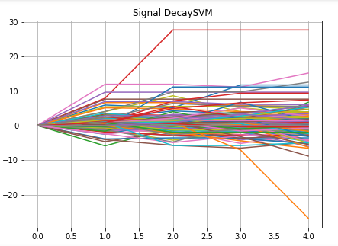
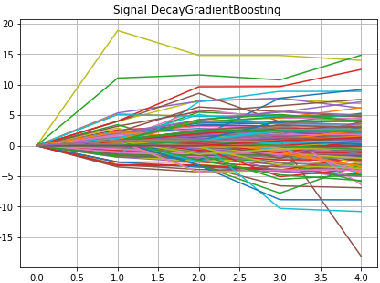
Predictive Power--Decay
P A R T 0 2
Decay indicates the loss in predictive power over time. If there is an increasing or decreasing trend of decay, we can obtain a better understanding of the impact of a trade.
However, the decay graphs in this case do not exhibit such trend. It suggests that the machine learning based model have not found a patten, or the periods are not long enough to show such pattern since we can only obtain limited minute-level data.

Slide 19
Summary
P A R T 03

Slide 20
Conclusion
P A R T 0 3
In this project, the strategy based on SVM can obtain the highest pnl, annual return and sharpe ratio, indicating that it is the most profitable and stable strategy comparing with Gradient Boosting Tree, Random Forest, Logistic Regreesion and Naive Strategy.
Our strategy performs much better than the reference naive strategy, as reflected in the higher annualized return and higher Sharp Ratio. This means our strategy can provide investors with more stable and attractive annual rate of return.

Slide 21
Future Work
P A R T 0 3
More well-designed parameters could be added to fit the model, in order to improve the complexity and the stability of the models. Such as the statistical significance of sentiment and other market factors like index price.
More research could be done on building a portfolio by adding more stocks in different sections and some fixed income products to reduce the risk.
Some changes could be made in the choice of trading methods, such as replacing the cycle of a single buy and a single sell with the possibility of continuous buying and selling. This is more practical and may lead to greater returns.
To achieve better performance and accuracy of the strategy, we could perform cross validation and tune hyperparameters after building each model.

Slide 22
Market Assumptions
P A R T 0 2
Here are some assumptions we made about the market
No tax.
Transaction cost: two sides commissions equals to 0.00002 * trading amount.
Shorting (allow borrowing to trade) is not allowed.

Slide 23
Thank you
12.14.2021

